Slide 1
Web services Architecture, SOAP basics
Web services
Jakub Klímek, Martin Nečaský
This work is licensed under a Creative Commons Attribution 4.0 International License.

Slide 2
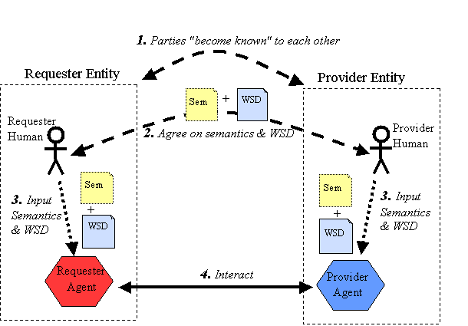
https://www.w3.org/TR/ws-arch/#engaging
Notes:
This is not focused on automatic discovery, although it does not prohibit it

Slide 3
Web Services Architecture
4 views of Web Services Architecture
Message Oriented Model
Policy Model
Resource Oriented Model
Service Oriented Model
Policy Model
Policy
Service Oriented Model
Resource Oriented Model
Action
Resource
Message Oriented Model
Message
https://www.w3.org/TR/ws-arch/#concepts
Notes:
Different points of view, same concepts may appear in multiple points of view

Slide 4
Message Oriented Model - simplified
The Message Oriented Model focuses on messages, message structure, message transport and so on
Agent
Headers
originates
processes
has
Message
Message
Transport
delivers
Body
has
Notes:
Agent
a software implementing a Web service
acting on behalf of a person or organization

Slide 5
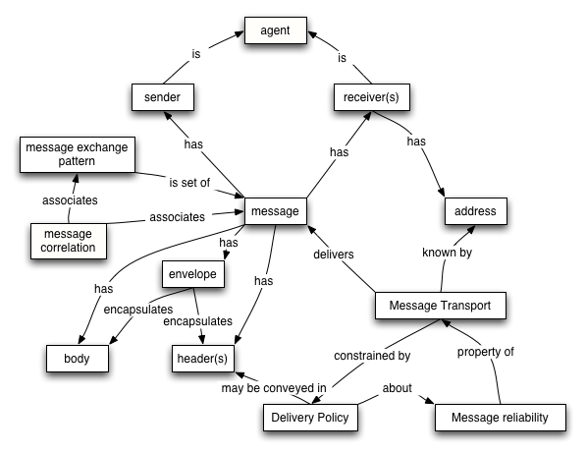
Message Oriented Model - full
http://www.w3.org/TR/2004/NOTE-ws-arch-20040211/#message_oriented_model
Notes:
A view oriented on messages being sent in the Web Services ecosystem

Slide 6
Policy Oriented Model - simplified
The Policy Model focuses on constraints on the behavior of agents and services.
Action
Person or organization
about
establishes
Policy
subject to
Agent
about
Resource
Notes:
Policies - rules of behavior in the Web Services ecosystems.

Slide 7
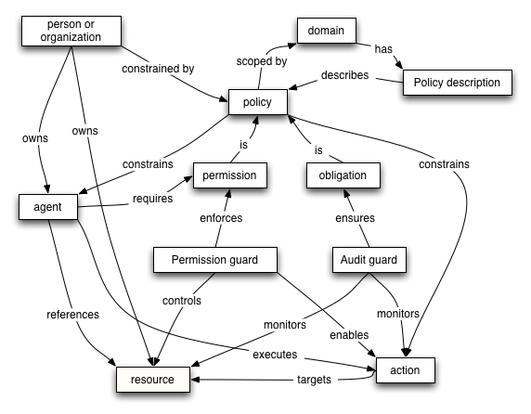
Policy Oriented Model - full
http://www.w3.org/TR/2004/NOTE-ws-arch-20040211/#policy_model
Notes:
Action - performed by an Agent
Permission guard - enables actions on resources when agent has permission
Audit guard - monitors that actions on resources meet obligations
Permission – what you can do, obligation – what are you supposed to do

Slide 8
Resource Oriented Model - simplified
The Resource Oriented Model focuses on resources that exist and have owners.
URI
Person or organization
has
owns
Resource
is
Service
may have
Representation
Notes:
Resource
anything that can have an identifier
may have reasonable representations
can be said to be owned (right to set policies)

Slide 9
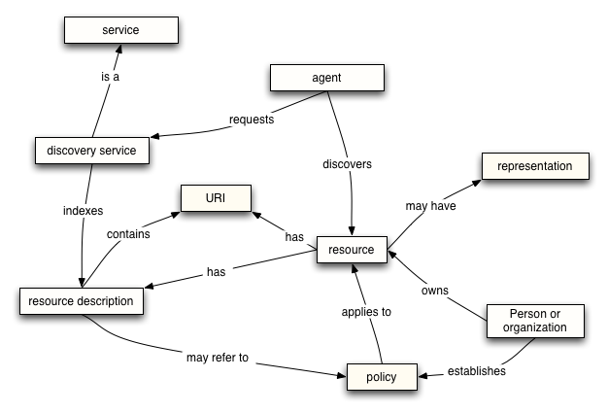
Resource Oriented Model - full
http://www.w3.org/TR/2004/NOTE-ws-arch-20040211/#resource_oriented_model
Notes:
Resource is a real-world thing, e.g. a timetable of a doctor
It has a resource description - metadata (e.g. in catalog)
It may have a representation - e.g. HTML page about the timetable or a JSON representation of the timetable

Slide 10
Service Oriented Model - simplified
The Service Oriented Model focuses on aspects of service, action and so on.
Message
Person or
Organization
signals
owns
Service
describes
uses
Metadata
realizes
Agent
Notes:
Agent - software

Slide 11
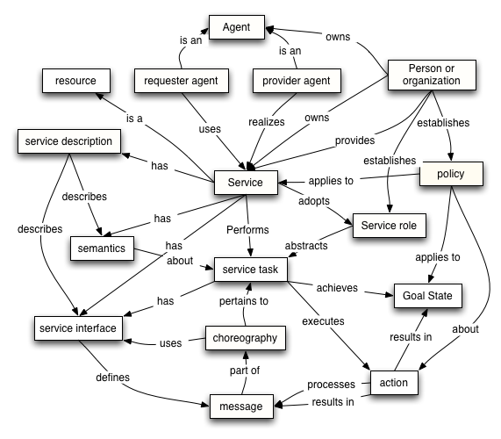
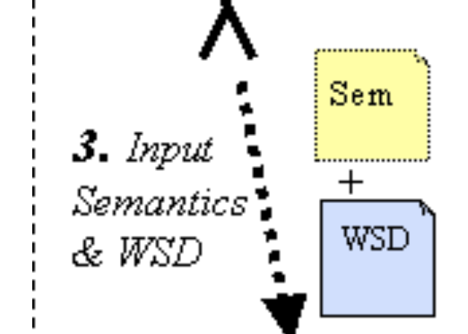
Service Oriented Model - full
Focus on:
Service
Policy
Action
Agent
Message
http://www.w3.org/TR/2004/NOTE-ws-arch-20040211/#service_oriented_model

Slide 12
Example of Web Services
VISA
WS
For applications, which
must interoperate over the Internet with other applications
and possibly are not designed to
cannot be designed, implemented and evolved at once as one piece
different parts run on different platforms
and are owned by different people/organizations
where scalability, security, etc. needs to be ensured
MasterCard
WS
Lufthansa
WS
…
Turkish Air.
WS
Travel Agent
WS
Search Hotel
WS

Slide 13
Advantages of Web Services
VISA
WS
MasterCard
WS
platform-independence
reusability
interoperability
scalability
adaptability
Lufthansa
WS
…
Turkish Air.
WS
Travel Agent
WS
Search Hotel
WS
Notes:
Platform independence
the web service specifications can be implemented on any platform
Reusability
one web service with a clearly defined task can be used in many business processes and scenarios
Interoperability
thanks to the specifications (SOAP, WSDL), web services and their clients implemented by various developers can communicate with each other
Scalability
if the service is self-contained, it can be deployed multiple times to scale
Adaptability
Implementation can be changed without affecting the interface

Slide 14
W3C-style Web Services
Processes
XSLT
BPEL
WS-CDL
Contract
XSD
WSDL
WS-Policy
Management
Security
Messages
SOAP extensions
XML
SOAP
Communications (HTTP, SMTP, …)
Notes:
WSDL (use XML schema), BPEL – will talk later...
SOAP protocol/technique – how message looks like on high level, based on XML
W3C-style web services are being used mainly in enterprise and government environments.
This is because there is a need for strong backing in specification, validation, etc. for numerous use cases - encryption, reliability, trustworthiness, ...
We will not talk about WS-CDL in this course.

Slide 15
W3C-style Web Services
WSDL
Web Service
SOAP
Interface
System
Message
Agent
Agent
Notes:
Message is formatted using SOAP

Slide 16
SOAP basics

Slide 17
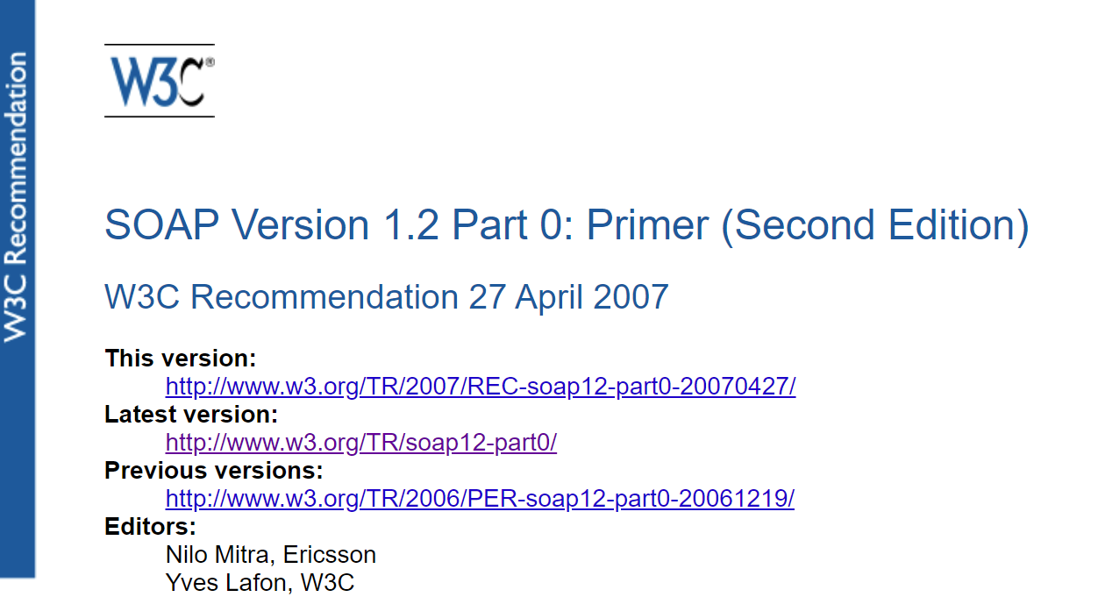
SOAP Basics
Simple Object Access Protocol
SOAP Version 1.2 Part 0: Primer (Second Edition) (2007)
There is also SOAP 1.1
W3C Note (2000)
protocol for inter-application communication
applications = peers in decentralized and distributed environment
Notes:
Both SOAP versions in use...

Slide 18
SOAP Basics
de facto standard protocol for communication with Web Services
W3C Recommendation
easily extensible
ideal for quickly evolving Web Service technologies
overcomes differences among proprietary heterogeneous peers
absolute necessity
lightweight
no need of specific environment to be installed
no configuration necessary
In SOAP 1.2, SOAP is no longer an acronym
“Simple Object Access Protocol” is misleading
SOAP is not Simple
SOAP is not only Object Access Protocol

Slide 19
SOAP Basics
SOAP
is stateless
implements a one-way message exchange paradigm
more complex communication patterns can be created (not covered by SOAP)
request/response
publish/subscribe
application-specific patterns with more communication rounds or more participants
Notes:
Server does not hold any info about previous message exchange

Slide 20
SOAP Basics: Message Syntax
SOAP message
is an XML document
envelopes exchanged data
is transferred over network via transfer protocol
a.k.a. protocol binding
e.g. HTTP, SMTP, …

Slide 21
SOAP Message Syntax
Sender
Receiver
HTTP/… message
HTTP/… message
SOAP message
SOAP message
exchanged
data
exchanged
data
Network
Notes:
SOAP „envelopes“ the data

Slide 22
SOAP Message Syntax
<Envelope>
SOAP standardizes 3 XML elements
Envelope
Header
Body
0..1
1
<Header>
<Body>
1..*
1..*
header block
body entry

Slide 23
SOAP Message Syntax
<?xml version="1.0" encoding="utf-8"?>
<env:Envelope
xmlns:env="http://www.w3.org/2003/05/soap-envelope">
<!-- Header is optional -->
<env:Header>
<!-- one or more header blocks -->
</env:Header>
<!-- Body is mandatory -->
<env:Body>
<!-- one or more body entries -->
</env:Body>
</env:Envelope>
SOAP 1.2
Notes:
Prolouge <?xml.....

Slide 24
SOAP Message Syntax
<?xml version="1.0" encoding="utf-8" ?>
<soap:Envelope xmlns:soap="http://schemas.xmlsoap.org/soap/envelope/" xmlns:xsi="http://www.w3.org/2001/XMLSchema-instance" xmlns:xsd="http://www.w3.org/2001/XMLSchema">
<soap:Header>
<RequesterCredentials xmlns="urn:ebay:api:PayPalAPI">
<Credentials xmlns="urn:ebay:apis:eBLBaseComponents">
<Username>paypal_1206382697_biz_api1.paypal.com</Username>
<Password>5CX9UDFSF2ZK7UYW</Password>
<Signature>AFcWxV3C7fdsdfsSFDS2342l31ApeELK3f4pOMPrCWOWerIYKvXni9</Signature>
</Credentials>
</RequesterCredentials>
</soap:Header>
<soap:Body>
<DoDirectPaymentReq xmlns="urn:ebay:api:PayPalAPI">
<DoDirectPaymentRequest>
<Version xmlns="urn:ebay:apis:eBLBaseComponents">57.0</Version>
<DoDirectPaymentRequestDetails xmlns="urn:ebay:apis:eBLBaseComponents">
<PaymentAction>Sale</PaymentAction>
<PaymentDetails>
<OrderTotal currencyID="USD">212.07</OrderTotal>
<ItemTotal currencyID="USD">198.39</ItemTotal>
SOAP 1.1
note the default namespace redefinitions
Notes:
Header is application specific, each header should have its own namespace xmlns=„...“

Slide 25
SOAP Message Syntax - Header Block
application specific XML element
carries data that is not part of application data itself
e.g. meta-data (message addressing, security, ...)
SOAP extension mechanism
SOAP modules
SOAP faults
<?xml version="1.0" encoding="utf-8" ?>
<soap:Envelope xmlns:soap="http://schemas.xmlsoap.org/soap/envelope/"
xmlns:xsi="http://www.w3.org/2001/XMLSchema-instance"
xmlns:xsd="http://www.w3.org/2001/XMLSchema">
<soap:Header>
<RequesterCredentials xmlns="urn:ebay:api:PayPalAPI">
<Credentials xmlns="urn:ebay:apis:eBLBaseComponents">
<Username>paypal_1206382697_biz_api1.paypal.com</Username>
<Password>5CX9UDFSF2ZK7UYW</Password>
<Signature>AFcWxV3C7fdsdfsSFDS2342l31ApeELK3f4pOMPrCWOWerIYKvXni9</Signature>
</Credentials>
</RequesterCredentials>
</soap:Header>
<soap:Body>
<DoDirectPaymentReq xmlns="urn:ebay:api:PayPalAPI">
<DoDirectPaymentRequest>
<Version xmlns="urn:ebay:apis:eBLBaseComponents">57.0</Version>
<DoDirectPaymentRequestDetails xmlns="urn:ebay:apis:eBLBaseComponents">
<PaymentAction>Sale</PaymentAction>
<PaymentDetails>
<OrderTotal currencyID="USD">212.07</OrderTotal>
<ItemTotal currencyID="USD">198.39</ItemTotal>
Notes:
SOAP is extensible -> because you can put in header blocks anything you want, SOAP just defines how to do it, and what to do when there is a problem

Slide 26
SOAP Message Syntax - Header Block - Extensions
SOAP extensions via header blocks:
specific languages extending SOAP
WS-Encryption, WS-Addressing, etc.
W3C, OASIS, etc.
each header block should have its own namespace
<?xml version="1.0" encoding="utf-8" ?>
<soap:Envelope xmlns:soap="http://schemas.xmlsoap.org/soap/envelope/"
xmlns:xsi="http://www.w3.org/2001/XMLSchema-instance"
xmlns:xsd="http://www.w3.org/2001/XMLSchema">
<soap:Header>
<RequesterCredentials xmlns="urn:ebay:api:PayPalAPI">
<Credentials xmlns="urn:ebay:apis:eBLBaseComponents">
<Username>paypal_1206382697_biz_api1.paypal.com</Username>
<Password>5CX9UDFSF2ZK7UYW</Password>
<Signature>AFcWxV3C7fdsdfsSFDS2342l31ApeELK3f4pOMPrCWOWerIYKvXni9</Signature>
</Credentials>
</RequesterCredentials>
</soap:Header>
<soap:Body>
<DoDirectPaymentReq xmlns="urn:ebay:api:PayPalAPI">
<DoDirectPaymentRequest>
<Version xmlns="urn:ebay:apis:eBLBaseComponents">57.0</Version>
<DoDirectPaymentRequestDetails xmlns="urn:ebay:apis:eBLBaseComponents">
<PaymentAction>Sale</PaymentAction>
<PaymentDetails>
<OrderTotal currencyID="USD">212.07</OrderTotal>
<ItemTotal currencyID="USD">198.39</ItemTotal>
helps identify relevant header blocks

Slide 27
SOAP Message Syntax - Body
application specific XML element
carries application data
end-to-end information
<?xml version="1.0" encoding="utf-8" ?>
<soap:Envelope xmlns:soap="http://schemas.xmlsoap.org/soap/envelope/"
xmlns:xsi="http://www.w3.org/2001/XMLSchema-instance"
xmlns:xsd="http://www.w3.org/2001/XMLSchema">
<soap:Header>
<RequesterCredentials xmlns="urn:ebay:api:PayPalAPI">
<Credentials xmlns="urn:ebay:apis:eBLBaseComponents">
<Username>paypal_1206382697_biz_api1.paypal.com</Username>
<Password>5CX9UDFSF2ZK7UYW</Password>
<Signature>AFcWxV3C7fdsdfsSFDS2342l31ApeELK3f4pOMPrCWOWerIYKvXni9</Signature>
</Credentials>
</RequesterCredentials>
</soap:Header>
<soap:Body>
<DoDirectPaymentReq xmlns="urn:ebay:api:PayPalAPI">
<DoDirectPaymentRequest>
<Version xmlns="urn:ebay:apis:eBLBaseComponents">57.0</Version>
<DoDirectPaymentRequestDetails xmlns="urn:ebay:apis:eBLBaseComponents">
<PaymentAction>Sale</PaymentAction>
<PaymentDetails>
<OrderTotal currencyID="USD">212.07</OrderTotal>
<ItemTotal currencyID="USD">198.39</ItemTotal>

Slide 28
SOAP 1.1 vs. SOAP 1.2 - Namespaces
Different namespaces
SOAP 1.1: http://schemas.xmlsoap.org/soap/envelope/
SOAP 1.2: http://www.w3.org/2003/05/soap-envelope

Slide 29
SOAP 1.1 vs. SOAP 1.2 - Content-type
Different message Content-Type
SOAP 1.1: text/xml
SOAP 1.2: application/soap+xml

Slide 30
SOAP Syntax - Faults
all SOAP-specific and application-specific faults are reported using single element Fault in Body
network transfer protocol faults are reported using other protocol-specific mechanisms, e.g.
HTTP response
another email via SMTP
SOAP Fault
separate SOAP message
mandatory Code and Reason
optional Detail, Node, Role

Slide 31
SOAP Syntax - Faults - VersionMismatch
<env:Envelope xmlns:env="http://www.w3.org/2003/05/soap-envelope"
xmlns:xml="http://www.w3.org/XML/1998/namespace">
<env:Header>
<env:Upgrade>
<env:SupportedEnvelope qname="soap1:Envelope"
xmlns:soap1="http://www.w3.org/2003/05/soap-envelope"/>
</env:Upgrade>
</env:Header>
<env:Body>
<env:Fault>
<env:Code><env:Value>env:VersionMismatch</env:Value></env:Code>
</env:Fault>
</env:Body>
</env:Envelope>
Notes:
SOAP version mismatch - request in SOAP 1.1 when server supports SOAP 1.2

Slide 32
SOAP Syntax - Faults - Code
reports specific kind of fault
particular kind of fault may require additional header blocks to be generated
mandatory Value
contains code value
optional Subcode
contains mandatory Value with application-specific sub-code value
Code | Semantics
VersionMismatch | Faulting node does not support the given version of SOAP. The node SHOULD specify how the messages should be upgraded with Upgrade header
MustUnderstand | Faulting node does not understand a header. The node SHOULD specify which header was not understood with NotUnderstood header
DataEncodingUnknown | Faulting node does not understand the message encoding
Sender | The message was incorrectly formed or did not contain the appropriate information in order to succeed. E.g. improper authentication details, registration information, etc.
Receiver | The message could not be processed for reasons attributable to the processing of the message rather than to the contents of the message itself. Something went wrong.

Slide 33
SOAP Syntax - Faults - Reason
for human understanding
contains description of fault in one or more Text elements
<?xml version="1.0" encoding="utf-8" ?>
<env:Envelope
xmlns:env="http://www.w3.org/2003/05/soap-envelope"
xmlns:xml="http://www.w3.org/XML/1998/namespace">
<env:Header>
<env:NotUnderstood qname="abc:Extension1"
xmlns:abc="http://example.org/2001/06/ext" />
<env:NotUnderstood qname="def:Extension2"
xmlns:def="http://example.com/stuff" />
</env:Header>
<env:Body>
<env:Fault>
<env:Code>
<env:Value>env:MustUnderstand</env:Value>
</env:Code>
<env:Reason>
<env:Text xml:lang="en">
One or more mandatory SOAP header blocks not understood.
</env:Text>
</env:Reason>
</env:Fault>
</env:Body>
</env:Envelope>

Slide 34
SOAP Processing Model - Intermediaries
SOAP message travels along path of SOAP nodes = SOAP message path
from initial SOAP sender
point of origin
to ultimate SOAP receiver
final destination
passes zero or more SOAP intermediaries
each SOAP node is identified by unique URI
Sender
Intermediary
…
Intermediary
Receiver
Notes:
So far, we used SOAP to communicate between 2 hosts - client and server.
However, SOAP supports more complex case
sender sends message
ultimate receiver receives message
in between, there may be SOAP intermediaries
each intermediary may do something to the message being passed.

Slide 35
SOAP Processing Model - SOAP node behavior
SOAP node workflow when receiving message
Validate SOAP message
Process SOAP elements (envelope, headers, body)
header blocks
MAY be processed by any SOAP intermediary and ultimate SOAP receiver
body
MAY NOT be processed by SOAP intermediary
MUST be processed by ultimate SOAP receiver

Slide 36
SOAP Processing Model - Intermediary behavior
processing SOAP message by SOAP intermediary results in
generating a single SOAP fault
or
forwarding (optionally updated) SOAP message
generating and sending zero or more additional SOAP messages
Notes:
Forward and e.g. log message info...

Slide 37
SOAP Processing Model - header attributes
SOAP header blocks have optional attributes used in SOAP message processing
role
mustUnderstand
relay

Slide 38
SOAP Processing Model - attribute role
SOAP node assumes one or more roles
for processing a single message
invariant during processing of a message
SOAP header block targets role by the role attribute
actor in SOAP 1.1
<env:Header>
<jj:maxTime value="10000" xmlns:jj="http://jenkov.com"
role="http://www.w3.org/2003/05/soap-envelope/role/ultimateReceiver" />
</env:Header>
Notes:
Only receiver can process this header block

Slide 39
SOAP Processing Model - attribute role
Value: URI
3 standard
http://www.w3.org/2003/05/soap-envelope/role/none (SOAP 1.2)
http://www.w3.org/2003/05/soap-envelope/role/next
http://www.w3.org/2003/05/soap-envelope/role/ultimateReceiver (SOAP 1.2)
application-specific, e.g.
https://jakub.klímek.com/resource/soap/roles/Log
https://jakub.klímek.com/resource/soap/roles/Encrypt
https://jakub.klímek.com/resource/soap/roles/Cache

Slide 40
SOAP - role - none
SOAP nodes MUST NOT act in this role
i.e. header block does not target any SOAP node
nodes can still look at the data in the header
http://www.w3.org/2003/05/soap-envelope/role/none

Slide 41
SOAP - role - ultimateReceiver
each SOAP ultimate receiver MUST act in this role
i.e. header block targets each SOAP node that assumes being ultimate SOAP receiver
this is default when role is not specified
http://www.w3.org/2003/05/soap-envelope/role/ultimateReceiver

Slide 42
SOAP - role - next
each SOAP intermediary and ultimate SOAP receiver MUST act in this role
i.e. header targets any SOAP node except initial SOAP sender
http://www.w3.org/2003/05/soap-envelope/role/next

Slide 43
SOAP Processing Model - node targeting
SOAP node is targeted by header block iff
SOAP node assumed role = header block role
Targeted SOAP node MAY process header block
processing according to application specific rules of that block
not part of SOAP
SOAP does not specify how SOAP node determines its roles
entirely application-specific task
can be known a priori
can be determined dynamically in run-time

Slide 44
SOAP Processing Model - mustUnderstand
Boolean value, default false
if true, targeted SOAP node MUST process header block
mandatory header block for that SOAP node
inability to process mandatory header block means that
single SOAP fault is generated
with code MustUnderstand
original SOAP message is not forwarded or processed any further
<env:Header>
<jj:maxTime value="10000" xmlns:jj="http://jenkov.com"
mustUnderstand="true" />
</env:Header>
Notes:
When targeted it MUST process that block

Slide 45
SOAP Processing Model - mustUnderstand
<?xml version="1.0" encoding="utf-8" ?>
<env:Envelope
xmlns:env="http://www.w3.org/2003/05/soap-envelope"
xmlns:xml="http://www.w3.org/XML/1998/namespace">
<env:Header>
<env:NotUnderstood qname="jj:maxTime" xmlns:jj="http://jenkov.com" />
</env:Header>
<env:Body>
<env:Fault>
<env:Code>
<env:Value>env:MustUnderstand</env:Value>
</env:Code>
<env:Reason>
<env:Text xml:lang="en">
One or more mandatory SOAP header blocks not understood.
</env:Text>
</env:Reason>
</env:Fault>
</env:Body>
</env:Envelope>

Slide 46
SOAP Processing Model - relay
Boolean value, default false
specifies forwarding header blocks by targeted SOAP intermediaries
relayable vs. non-relayable header blocks

Slide 47
Processing SOAP header blocks
determine roles of SOAP node
identify targeting header blocks
if one or more mandatory header blocks are not understood
generate SOAP fault
exit
process header blocks (application specific)
Mandatory – mustUnderstand=true
optionally non-mandatory
if you are SOAP intermediary then relay header blocks

Slide 48
Relaying SOAP header blocks by intermediaries
header block targeting SOAP intermediary
processed block is removed
ignored and non-relayable block is removed
ignored and relayable block is retained
header block not targeting SOAP intermediary is retained
optionally, header blocks are added, modified or removed
1. + 2. = Forwarding SOAP intermediary
1. + 2. + 3. = Active SOAP intermediary
Notes:
retained = kept in the message, which is then passed along the SOAP message path

Slide 49
Relaying SOAP header blocks by intermediaries
SOAP Header
Header Block A
role="Annotate"
mustUnderstand="true"
Header Block B
role="Annotate"
relay="true"
Sender
Header Block C
role="next"
Header Block D
role="Log"

Slide 50
Relaying SOAP header blocks by intermediaries
SOAP Header
SOAP Header
Header Block A
role="Annotate"
mustUnderstand="true"
Forwarding
Intermediary
Header Block B
role="Annotate"
relay="true"
Header Block B
role="Annotate"
relay="true"
roles:
Annotate
next
Header Block C
role="next"
ignores:
Header Block B
Header Block D
role="Log"
Header Block D
role="Log"
Notes:
A is processed, C is also processed.
B has relay, so it is relayed.
D is not targeting the intermediary, so it is forwarded

Slide 51
Relaying SOAP header blocks by intermediaries
SOAP Header
SOAP Header
Header Block A
role="Annotate"
mustUnderstand="true"
Header Block A
role="Annotate"
mustUnderstand="true"
Active
Intermediary
Header Block B
role="Annotate"
relay="true"
Header Block B
role="Annotate"
relay="true"
roles:
Annotate
next
Header Block C
role="next"
ignores:
Header Block B
Header Block E
role="next"
Header Block D
role="Log"
Header Block D
role="Log"
Notes:
In addition to relaying B and D, an Active intermediary relays A and adds E.

Slide 52
SOAP Header and SOAP Body revisited
what information should be part of header and what should be placed in body?
decision made during application design
Header | Body
may be processed and updated by SOAP intermediaries SOAP intermediaries provide value-added services based on header blocks | primary content processed only by ultimate SOAP receiver must be understood by ultimate SOAP receiver

Slide 53
RPC-style web services
web service appears as remote object
request
method call with name and set of typed arguments
response
return value
automatic serialization/deserialization of method calls and return values
tightly coupled client and service
hard-coded
usually synchronous
allows for exposing software components as web services
servlets, Java RMI objects, …
components natively DO NOT exchange XML data
Notes:
Rpc – remote procedure call

Slide 54
RPC-style web service example
Interface
package com.jakubklimek.nswi145; import javax.jws.WebMethod; import javax.jws.WebService; import javax.jws.soap.SOAPBinding; import javax.jws.soap.SOAPBinding.Style;
@WebService @SOAPBinding(style = Style.RPC) public interface UC { @WebMethod double c2f(double degrees); }
Client
package com.jakubklimek.nswi145.client; import java.net.URL; import javax.xml.namespace.QName; import javax.xml.ws.Service; import com.jakubklimek.nswi145.UC; public class SimpleClient { public static void main(String[] args) throws Exception { URL url = new URL("http://127.0.0.1:8000/UC?wsdl"); QName qname = new QName("http://nswi145.jakubklimek.com/", "UCImplService"); Service service = Service.create(url, qname); UC convertor = service.getPort(UC.class); System.out.println(convertor.c2f(37)); } }

Slide 55
RPC-style web service example
<soapenv:Envelope xmlns:soapenv="http://schemas.xmlsoap.org/soap/envelope/" xmlns:nsw="http://nswi145.jakubklimek.com/">
<soapenv:Header/>
<soapenv:Body>
<nsw:c2f>
<arg0>37</arg0>
</nsw:c2f>
</soapenv:Body>
</soapenv:Envelope>
System.out.println( convertor.c2f(37) );

Slide 56
RPC-style web service example
Server
<soapenv:Envelope xmlns:soapenv= "..." xmlns:nsw= "http://nswi145.jakubklimek.com/">
<soapenv:Header/>
<soapenv:Body>
<nsw:c2f>
<arg0>37</arg0>
</nsw:c2f>
</soapenv:Body>
</soapenv:Envelope>
package com.jakubklimek.nswi145;
import javax.jws.WebService;
@WebService(endpointInterface = "com.jakubklimek.nswi145.UC")
public class UCImpl implements UC {
@Override
public double c2f(double degrees)
{
return degrees * 9.0 / 5.0 + 32;
}
}

Slide 57
RPC-style web service example
Server
package com.jakubklimek.nswi145;
import javax.jws.WebService;
@WebService(endpointInterface = "com.jakubklimek.nswi145.UC")
public class UCImpl implements UC {
@Override
public double c2f(double degrees)
{
return degrees * 9.0 / 5.0 + 32;
}
}
<S:Envelope xmlns:S="...">
<S:Body>
<ns2:c2fResponse xmlns:ns2= "http://nswi145.jakubklimek.com/">
<return>98.6</return>
</ns2:c2fResponse>
</S:Body>
</S:Envelope>

Slide 58
RPC-style web service example
<S:Envelope xmlns:S="...">
<S:Body>
<ns2:c2fResponse xmlns:ns2= "http://nswi145.jakubklimek.com/">
<return>98.6</return>
</ns2:c2fResponse>
</S:Body>
</S:Envelope>
Client
System.out.println( convertor.c2f(37) );

Slide 59
Document-style web service
exchanging any documents (any information)
documents encoded in XML
no automatic serialization/deserialization of documents in XML
exchanged documents are primarily encoded in XML by application
closer to real-world
communication between real-world "components" instead of software components
typically asynchronous

Slide 60
SOAP Advantages - Modularity
SOAP Envelope
http://digsig.com/standard
SOAP Header
Digital signature
library
Header Block
http://thirdparty.com/ws-trans1-0
Header Block
Transactions 1.0
library
SOAP Body
http://fourthparty.com/ws-trans2-0
Transactions 2.0
library

Slide 61
SOAP Advantages - Modularity
SOAP Envelope
SOAP Header
PayPalAPI v 1.0
library
urn:ebay:api:
PayPalAPI
SOAP Body
PayPalAPI v 1.1
library
Message
urn:ebay:api:
PayPalAPI11

Slide 62
SOAP 1.1 vs. SOAP 1.2 - Header attributes
Differences in header attributes:
SOAP 1.1 | SOAP 1.2
actor | role
mustUnderstand=1/0 | mustUnderstand=true/false
 | relay

Slide 63
SOAP 1.1 vs. SOAP 1.2 - Fault
Different element names in Fault
SOAP 1.1 | SOAP 1.2
faultcode | Code (Value, Subcode)
faultstring | Reason (Text)
faultactor | Node
detail | Detail
 | Role

Slide 64
SOAP 1.1 vs. SOAP 1.2 - SOAPAction
SOAPAction
URI identifying the intent of the message
May be used by firewalls for filtering, etc.
1.1: A separate SOAPAction HTTP header
"Content-Type: text/xml; charset=UTF-8" "SOAPAction: http://example.org/PostSomething"
1.2: Part of the Content-Type HTTP header
"Content-Type: application/soap+xml;charset=UTF-8;action="http://example.org/PostSomething"
Notes:
Firewalls typically do not want to parse application-level data (bodies of HTTP messages).
Therefore, it may be beneficial to state the intent of the message on HTTP level - via HTTP header, which gets parsed by a firewall, etc.

